Slide 1
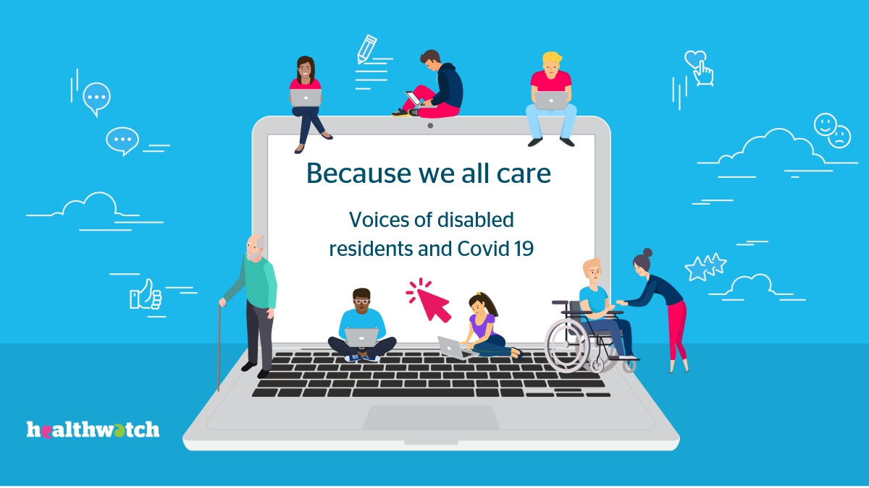
North East London July 2021

Slide 2




Table of contents
Summary
Who we engaged
Page 4
What we learned
Page 5
Communication and information
Page 6
Access to health and care services
Page 7
Questions for the health and care system
Page 9
Our respondents
Page 11
Impact of Covid
Page 12
Staying informed
Page 13
Accessible information
Page 15
Page 17
Online communication
Page 19
People with sight impairments
Neurodivergent,& people with learning disabilities
Page 20
Black, Asian and Minority Ethnic communities
Page 21
Covid vaccine
Page 22
Health & Care services
Page 27
Page 29
GP surgeries
Hospital services
Page 32
Mental health services
Page 35
Care at home
Page 38
Day care centres
Page 39
What difference has it made?
Page 40

Slide 3
Voices of disabled residents
Summary

Slide 4

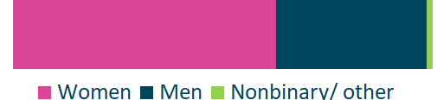


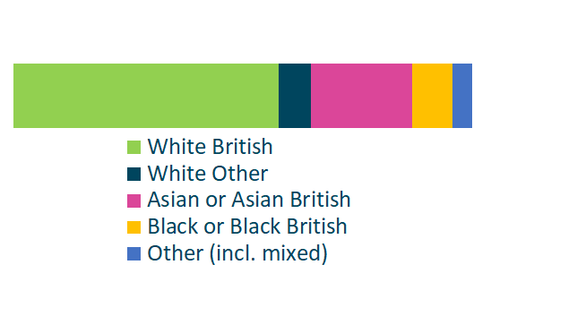

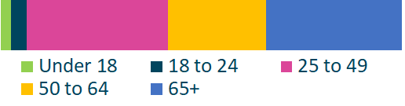
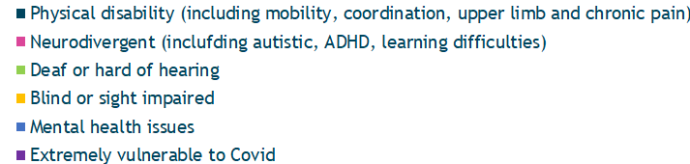
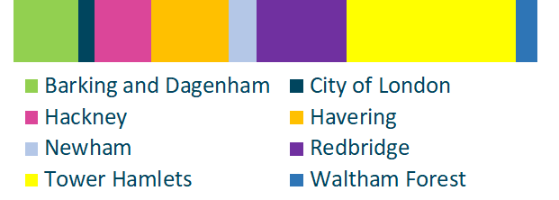
We carried out a survey
580 residents
who were disabled
Who we engaged
or living with a serious long-term conditions
Gender
63%
36%
1%
54%
Their disabilities
58%
7%
22%
9%
Ethnicity
4%
24%
15%
25%
24%
20%
13%
Age
35%
34%
2%
4%
Borough
11%
9%
13%
4%
15%
28%
3%
4%

Slide 5



What we learned
Communication & information
No "one size fits all" solution
Strategies that work well:
41%
Clear, straightforward online and email information is useful for younger people, those who are economically active and for some autistic people; but less accessible for those with learning disabilities and from ethnic minorities (especially Black) communities.
used the internet to stay informed about Covid.
Easyread materials featuring graphic illustrations, large fonts and strong contrasts are useful not just for users with learning disabilities, but also for people with some sight impairments or neurological disorders, and for those who are not fluent in English, including Deaf BSL speakers.
32%
were digitally excluded
An easyread front page containing essential information could be added by default to all letters sent by the NHS or Government regarding health and social care.
15%
preferred information that does not involve the written word.
Information which is not in writing could entail online videos, podcasts, radio broadcasts as well as outreach by telephone or in person. It would be more accessible to those who are sight impaired, have learning disabilities or who prefer oral communication for cultural reasons.

Slide 6




Communication & information
What we learned
Communication strategy
No "one size fits all" solution
GPs could play a crucial role in disseminating information.
Personalised outreach can make information more accessible
They are already seen by most patients as a trusted authority when it comes to health and social care information.
Collecting and recording data on each person's specific communication needs and offering different options (such as contact by phone, text or online video sent by email) would empower health and social care professionals to contact them in the way they prefer to be contacted, and to ensure accessibility.
Through patient records, they have (or could obtain) specific information on each person's communication needs
Disabled people could communicate their contact preferences ONCE, through GP surgeries; and through integrated care systems these would be used across the NHS

Slide 7


Access to health & care services
What we learned
Communication strategy
Covid-19 related disruptions have created a backlog of untreated cases in non-urgent healthcare; especially affecting secondary and specialist care.
Services experiencing the most cancellations:
53%
experienced disruption in their healthcare or social care.
  Hospital outpatients
  Community services (such as chiropody or physiotherapy)
To manage this backlog we need a fair and transparent prioritisation system.
  Day centres
Prioritise issues that would be likely to worsen and become more resource-intensive to treat if not addressed promptly.
Work with primary care providers, social care providers and community services to offer temporary alternatives, including pain management, occupational therapy, reablement care and social prescribing.
People most affected by disruptions in healthcare/ social care are also the most vulnerable:
  People with more severe disabilities (unable to work or leave home, in need of personal care).
Communicate transparently about waiting lists; update patients regularly on the time they have to wait and how they can manage in the meantime; offer reassurance that it is safe to wait.
  People with learning disabilities.
  People living with chronic pain.
  People aged under 65, particularly children under 18.
  People from BAME backgrounds
Consider de-centralising some hospital-based services to community healthcare hubs.
  Digitally excluded people

Slide 8



Access to health & care services
What we learned
Communication strategy
Most respondents experienced telephone or
online consultations:
Some Covid-19 safety measures can make clinical spaces less accessible to disabled people.
More online and telephone consultations can be beneficial for some, such as those who cannot easily travel because of constraints in their physical or mental health; but are not accessible to all. Those with sensory impairments, learning disabilities or a language barrier are the most likely to struggle.
For example, the requirement to wear a mask and ring the door before entering can be challenging for people with hearing impairments who need to lip-read.
Investment in both telephone infrastructure and online access pays off in the long run:
While telemedicine is not suitable for/ accessible to everyone, a responsive telephone and e-consult system, free of technical errors and adequately staffed, can offer a good service to those who do benefit from it, and free up capacity for those who do not.

Slide 9

What next
Questions for the health and care system
Meeting accessible standards
  Can we enable a system where a patient/user can choose their communication preferences (e.g BSL, Easyread, online/not online) once and then those preferences can be shared across the health and care system if people wish?
  Should we be co-designing tools for key impairment groups? People with learning disabilities seem to be the most effected, should we start with this group? If you can get things right for people with learning disabilities it will also help a wide range of other groups. How can we make it easier for people to contact us and communicate with us?
Delays in care
  How can we support people while they wait for treatment that has been delayed due to Covid?
  How can we make communication about waiting lists as transparent as possible?
  Can we improve the appointments process giving people?
  as much advance notice as possible.
  more regular updates on waiting times, where they are in the list and any changes.
  a clearer point of contact within the service.
  more information and support on how to manage their condition while they wait
  Can we build stronger links with community care particularly around mental health and long term care?
  What role can GPs, community services and the voluntary and community sector play re:pain management, mental health, occupational therapy, reablement care and social prescribing e.g supporting better mental health.
Telemedicine
What kind of investment would we need to improve telephone and online access? Is such investment available at the moment?

Slide 10
Voices of disabled residents findings

Slide 11




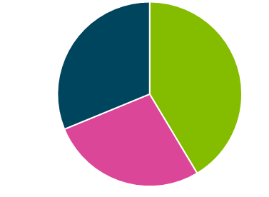


Our respondents
Living circumstances and wider context
  Respondents were diverse in terms of care needs and living circumstances, ability to work, leave the house and use online services.
42%
received personal care
17%
9%
37%
28%
were working full-time or part-time
were studying, jobseeking or volunteering
were shielding during the pandemic
rarely or never left home because of their disability
73%
from family
members
20%
were unable to work because of their disability
35%
34%
from paid carers
30%
were able to leave home on a reasonably regular basis
were retired.
32%
were digitally excluded

Slide 12



Impact of Covid
  Disruptions to health and social care were an issue for most respondents, but they disproportionately affected the most vulnerable and those with the more severe disabilities.
  Young people with disabilities were at risk of social isolation.
Most affected by disruptions in healthcare/ social care:
  People living with chronic pain
  people with learning disabilities
  People from BAME backgrounds
  Digitally excluded people
  People aged under 65, particularly children under 18.
  People with more severe disabilities (unable to work or leave home)
53%
17%
Most affected by social isolation:
said they can no longer travel or engage in their hobbies
experienced disruption in their healthcare or social care.
  People aged under 25
  People of White non-British ethnicities
12%
9%
5%
became unable to see friends or loved ones
experienced poorer mental health
became less physically active

Slide 13





















  Mass-media was the most popular source of information about Covid-19
  TV news, the NHS website and Gov.uk were trusted sources of information.
  People with learning disabilities or sight impairments may struggle with online and mass media
  BAME respondents rely more on word of mouth and less on online sources for staying informed.
Staying informed
How respondents stayed informed about Covid
4%
depended exclusively on friends and family for information.
They were more likely to belong to these groups:
61%
41%
38%
35%
Neurodivergent/LDs
Sight impaired
Women
26%
BAME, especially black ethnicities
Digitally excluded
Traditional
media
(TV, radio, newspapers)
Internet and social media
Friends and family
Letter or text from Govt or NHS
Health or social care professionals
Most likely to use online sources
Least likely to use online sources
  Neurodivergent/ learning disability
  Blind or sight impaired
  Severely disabled (requires personal care, rarely leaves home)
  Black ethnicities
  Aged over 65
  Mental health-related disability
  White non-British ethnicities
  Aged under 65
  Economically active (worker or jobseeker)
Most used traditional media sources
Most used online sources
78%
46%
44%
TV
33%
31%
27%
NHS
website
Govt
website
Social media
Radio
Print
* as % of those who said they use the respective source

Slide 14
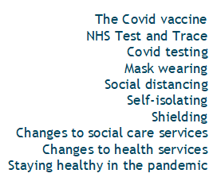
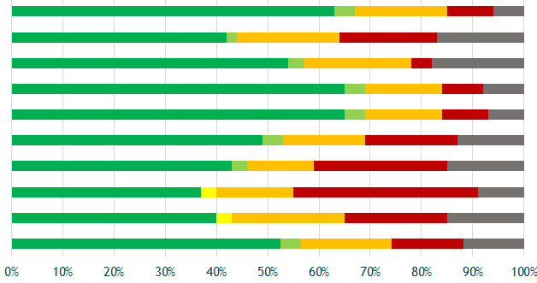

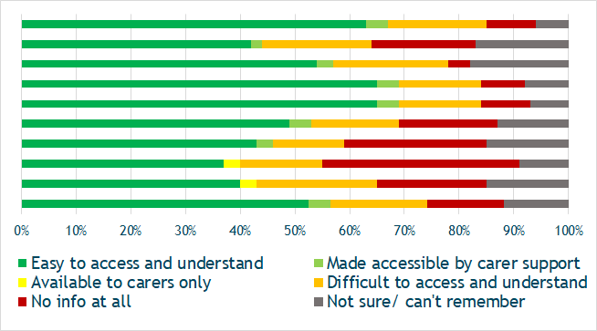

  Respondents felt quite well-informed about the Covid vaccine, social distancing and mask-wearing, but poorly informed about changes to their social care and about NHS Test and Trace.
  Respondents who were autistic, living with learning disablilities or with sensory impairments were less likely to find accessible information.
Staying informed
Information about Covid-related topics
Most likely to find accessible information:
  Those in work or education.
  Those aged 25 to 64.
  Those living with a partner or children.
Least likely to find accessible information:
  Autistic respondents.
  Respondents with learning disabilities.
  Respondents with sensory impairments.
  Digitally excluded respondents.
  Those who only had info from friends and family.
11%
8%
14%
14%
found the font in printed materials too small
found the language too complicated
felt there was too much information
felt there was not enough information

Slide 15



Accessible information
  There is no 'one size fits all' solution for communicating with disabled people on topics such as their health services in the pandemic and Covid vaccination.
  Information presented simply, with clear explanations, is accessible to more people.
  Written materials can be made more accessible with large print and plain formatting; however, some may do better with information that is not in written English.
Information which is NOT in writing may be more accessible to:
24%
of respondents expressed a need for information to be presented in plain, jargon-free language with simple explanations.
Those with sight impairments;
15%
expressed a need for written materials to be formatted in a disabled-friendly way (large print, plain background, no unnecessary embellishments)
Deaf people who use British Sign Language;
People with
learning disabilities;
15%
preferred to receive information in formats that did not involve the written word (such as by telephone, video call or in person)
41%
of respondents with a sight impairment preferred info that was NOT written.

Slide 16

Accessible information
  Since different groups have different needs, it is necessary to have a bespoke, individualised approach that feels relevant to those targeted.
  Bespoke strategies should be formulated for reaching out to disabled people who are digitally excluded or unable to communicate.
I prefer to receive official communication from the government either via post addressed to me personally, or via an official email where there aren’t too many links to click on to find the information.
Individualised Outreach
Some people, like those with profound learning disabilities or advanced dementia, may not be able to understand information, therefore outreach should target THEIR CARERS.
(Havering resident)
entails targeting and addressing certain groups of people specifically, including tailoring the message and presentation to their own needs.
My elderly, stroke survivor husband watches the news, but he doesn't see himself as vulnerable. If the doctor rings he gives it to me to deal with. He just doesn't really see the vulnerable as being him.
My father has dementia. You would need to pass information onto him via family and carers, and we would convey to him. We would like to be mailed and emailed the information.
(Tower Hamlets resident)
Information sent directly or addressed specifically to the target audience is less likely to be ignored; though special consideration needs to be given to whether it is accessible and suitable.
The information that I receive needs to be relevant to me.
(Hackney resident)
(Barking and Dagenham resident)

Slide 17


Online communication
  Online information should be simple, easy to read, free of clutter and optimised for smartphone access.
  Communication should not excessively rely on online information, as many disabled people, particularly the elderly, those with cognitive and sight impairments are likely to experience bariers to accessing online services.
Accessible information
32%
38%
52%
58%
8%
of all respondents were digitally excluded.
of neurodivergent respondents were digitally excluded.
of sight impaired respondents were digitally excluded.
of respondents aged 65+ were digitally excluded.
Found it hard to stay informed about Covid because websites were too complicated.
Messages should be sent electronically by text and email and include clickable links for easy access on a mobile phone.
I've received an email from the council- but those who are digitally excluded must have missed out on information. These people will only be informed by their families and sometimes the information is very minimal.
Send me information at home as a leaflet, that way people who can't go outside or go on the internet can access it and not miss anything.
(Tower Hamlets resident)
Do not use two columns on an iPhone and ensure text is at a reasonable size (not necessarily to be large as standard, just not small )
(Tower Hamlets resident)
(Tower Hamlets resident)
Some people don't have smartphones for Test and Trace- this should be made easier for them.
(Havering resident)
Easier access via a smartphone. Too much information is available only as a PDF which is best viewable on a much larger screen.
(Havering resident)
(Tower Hamlets resident)

Slide 18



Accessible information
People with sight impairments
  Written text should be in large print, with bold fonts, constrasting colours and avoiding unnecessary clutter.
  Alternatives to written information (such as audio/video, contact by telephone or in person) should be considered for those who cannot read.
People with sight impairments may not always be able to read written text; providing information in other formats, such as audio or video, may be more accessible for some of them.
of respondents with a sight impairment said they would like to receive information in formats other than written text.
41%
For those who are able to read, the use of large print, bold fonts and contrasting colours (such as black lettering on white background) can help.
of respondents with a sight impairment said they would like to receive written information in large text, with accessibe formatting.
41%
Online resources should consider compatibility with adaptive software such as screen readers.
There should be more use of telephone access for enquiries, as people wish to speak to a person. Being vision impaired, websites and social media platforms are not easy to access and use. Older people have enough to deal with with their sight loss and don't want a battle to find information.
The accessible information standard is not being applied in many health settings. Despite filling a form in at my GP surgery they had no record of my preferred format and kept sending me letters which I cannot read.
I received info by phone from Healthwatch Hackney and it was critically helpful.
(Hackney resident)
Health professionals should have the various degrees of visual impairment their patients have highlighted so they are aware when contacted.
(Havering resident)
(Havering resident)
(Tower Hamlets resident)

Slide 19

People with hearing impairments
Accessible information
People with hearing impairments
  Subtitling informative videos can make them more accessible to people with hearing impairments; but it is important to make them large and easily legible, as some people with hearing impairments are also sight-impaired.
  Written text is accessible for those who experienced hearing loss or who are partially impaired, but may be less so for native speakers of BSL.
of respondents with a hearing impairment also had a sight impairment.
6%
of respondents with a hearing impairment said they found it harder to access the information they needed because it was not available in BSL.
16%
of respondents with a hearing impairment said they found it harder to access the information they needed because the language used was too complicated.
of respondents with a hearing impairment said they found it harder to access the information they needed because it was not subtitled.
11%
9%
Easyread materials
may be more accessible to native speakers of British Sign Language than standard text; simple, accessible formatting is better for those who experience both sight and hearing loss.
There should be information posted to residents who have disabilities, in large writing and easy to digest.
Face coverings make it harder for me to understand people. You don't know how much you rely in reading lips until you cannot see them, if there is background noise it's impossible - try listening to someone with your head in a bucket of water and the person wearing a mask - that is what it sounds like.
(Tower Hamlets resident)
Plain language, and videos being subtitled and signed would help me a lot.
(Havering resident)
(Newham resident)
Health briefings should be subtitled, and Relay UK should be used when talking to doctors. I'd like to receive leaflets through the door.
(Redbridge resident)

Slide 20
Accessible information
Neurodivergent,& people with learning disabilities
  Easyread materials, featuring visuals and simple explanations using plain, jargon-free language may help neurodivergent respondents stay informed.
  The written language is not a suitable medium for all; some respondents would be better able to understand information presented visually or in a face to face conversation
Easyread materials
of neurodivergent respondents said they found it harder to stay informed about Covid because they found the language too complicated.
of neurodivergent respondents said they would like the informative materials they receive to contain images and illustrations
15%
59%
combining images, basic explanations in plain language and simple formatting may be more accessible than standard text.
30%
of neurodivergent respondents said they would like to receive infomation in plain language, with easy to understand explanations
30%
of neurodivergent respondents said they would like to receive information in formats other than written text.
Use social stories or videos suitable for younger people and children who have communication difficulties.
Someone visiting the sheltered accommodation staff members could give information and explain to residents. It is difficult when someone has dementia and we as a family are trying to support, but lodge has restrictions.
Speak to the general public with clearer information and language rather than changing/chopping advice constantly Easy to read visuals are easy - with good colour schemes and accessible information. TfL posters and promotions are eye-catching and effective but could do with updating e.g. relating to the vaccine
(Barking and Dagenham resident, parent of child with learning difficulties)
(Redbridge resident, family of adult with dementia)
Easy Read is not difficult to produce and I need it in these situations.
Information could be provided in an audio format as well as a written document. For example a podcast.
(Tower Hamlets resident)
(Barking and Dagenham resident)
(City of London resident)

Slide 21



Accessible information
Black, Asian and Minoirty Ethnic communities
Written materials in a variety of languages may be helpful to some BAME respondents, but wider cultural considerents may need to be taken into account; such as the fact that people with more oral cultures may be more responsive to direct outreach and multimedia materials than to written information.
BAME respondents were more likely to prefer
Voice recording or perhaps some form of taping of news from like BBC Somalia or something similar. When we were back home we did shared information over the radio so maybe something similar to that.
It's easier for me when it's a diagram rather than words or even when someone is talking at me, I miss stuff or my mind wanders. If they had a visual version it would have been easier
information that is not in writing.
(Tower Hamlets resident, Bangladeshi)
(Tower Hamlets resident, Somali)
Make informative materials much shorter and simpler. with colourful pictures, sketches, cartoons and regular cheerful prompts, videos and voice messages.
of respondents of non-White ethnicities said they would need ro receive information in languages other than English.
I prefer telephonic communication in my native language so I can understand.
7%
(Tower Hamlets resident, Bangladeshi)
(Newham resident, Malay)
of respondents of White non-British ethnicities said they would need ro receive information in languages other than English.
3%
Doctors should explain things clearly, step by step.
(Tower Hamlets resident, Black African)

Slide 22





  Most respondents are willing to be vaccinated, and prefer to receive information from their GP.
  Vaccine hesitancy in the BAME community can be tackled by addressing myths and rumours circulating.
  A small number of respondents living with long-term conditions feel that they are not receiving sufficient information specific to their circumstances.
Covid vaccine
85%
66%
Some respondents living with long-term conditions expressed a desire for more specific information relating to their specific cirumstances.
intend to have the Covid vaccine or have had it already
of those who intend to have the vaccine would prefer to be informed by
their GP
I'm waiting from a call from my MS nurse to be 100% clear that I can have it; she OK'd this and I am ready to take it.
I have no doubts about the safety of the vaccine, but I know that I am Immunosuppressed and I am susceptible to catching infections, so I am unsure if the vaccine will work effectively, and I have not been able to ascertain the information about M.E and the Covid vaccine, and if any particular vaccine will be more efficacious.
(Tower Hamlets resident, diagnosed with Multiple Sclerosis)
(Tower Hamlets resident, diagnosed with ME/CFS)
Respondents most likely to be vaccine hesitant:
A lot of people of BAME heritage are very reluctant to take the vaccine as they’ve been exposed to many conspiracy theories.
The BAME community have the lowest take up rates this needs to be addressed The wider issue is equal access for all to health services the perception is that this community believes it does not have equal access The outcomes for them are also poorer.
  Only received info about Covid from friends and family.
  Felt poorly informed about Covid-related topics.
(Hackney resident, Black African)
  Were neurodivergent.
(Redbridge resident, Asian British)
  Were of Black ethnicities.

Slide 23
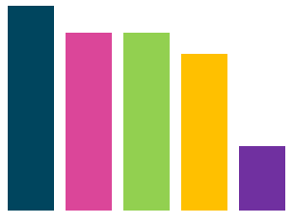
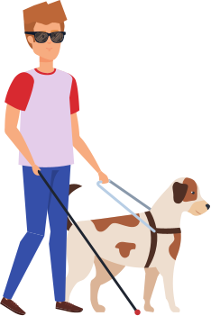



Many prefer to be contacted via email, text or letter. However, written info is not accessible to all; some groups such as those who are sight impaired, Deaf or neurodivergent could benefit from alternative methods of communication.
Covid vaccine
How respondents prefer to be contacted about the vaccine
Not a "One size fits all" approach
38%
12%
would prefer to only be contacted verbally, via phone or face to face, without written text.
33%
33%
29%
54%
of respondents with sight impairments preferred to be contacted by
phone
12%
Email
Letter
SMS
Phone
Face
to face

Slide 24
Covid vaccine
Not a "One size fits all" approach
Email was preferred by:
SMS was preferred by:
Phone was preferred by:
Letter was preferred by:
  Autistic respondents;
  Respondents with hearing impairments;
  Respondents who were shielding;
  Respondents who were economically active.
  Respondents with mental health issues;
  Respondents of White non-British ethnicities;
  Women.
  Responding with sight impairments;
  Respondents with learning dissabilities;
  Respondents who are shielding;
  Respondents who are digitally excluded;
  Respondents aged 65+.
  Respondents of ethnicities other than White British
  Respondents aged 25 to 49;
  White British respondents.
Letter was less popular for:
  Autistic respondents;
  Respondents with sight impairments.
SMS was less popular for:
Email was less popular for:
  Respondents with sight impairments;
  Respondents aged under 18 or over 65;
  Respondents of Asian ethnicities.
Face to face was preferred by:
  Respondents with learning disabilities;
  Respondents with sight impairments;
  BAME respondents, particularly Black ethnicities;
  Respondents aged under 24 or over 65.
  Respondents with learning disabilities;
  Respondents with sight impairments;
  Respondents of Asian ethnicities;
  Respondents of White non-British ethnicities.
Phone was less popular for:
  Autistic respondents;
  Respondents with mental health issues;
  Respondents aged 18 to 24.
Face to face was less popular for:
  Autistic respondents;
  Respondents with hearing impairments;

Slide 25





  Accomodation needs to be made for wheelchair users, as well as for those who cannot stand for too long.
  Access to toilets is essential for people with some long-term conditions.
  People need to be able to get to vaccination centres easily; helpful measures include keeping them local and near public transport, providing parking and a transport service.
Covid vaccine
Excel didn't have toilets on same level, this is a problem especially if you have a long journey from home (we don't all have cars).
Measures to make vaccination sites accessible for people with physical disabilities
(Tower Hamlets resident, walking stick user)
Ensure there are enough vaccination sites, so that they are near to home and that they are well managed when one gets there.
I thought all of this was good as site was near to my home and well managed, and friendly.
Ensure wheelchair accessibility, including ramps and lifts.
Provide access to toilets, including for wheelchair users.
(Tower Hamlets resident with asthma)
Provide seating for people who cannot stand for long.
Ideally, this could include reclining or lying down.
Make sure if they haven’t got a car they can use something like hospital transport and the place is wheelchair accessible, with lifts if it is on a different floor.
Provide parking and a free or cheap transport service.
Ensure locations are easily accessible by public transport.
(Tower Hamlets resident with chronic pain)
Any disabled person should be vaccinated at home in my view. Going out into the community was senseless when people have shielded for several months.
Ensure everyone has access to vaccination in their local area.
(For example, through their GP surgery)
(Barking and Dagenham resident, carer)
Offer vaccination at home for those who cannot leave it easily.
(For example, through district nurses or carers)
See if we can access the site without having to wait outside or stand; this was a huge issue for me. I'm unable to walk properly and stand caused more intense pain.
(Tower Hamlets resident with severe arthritis)

Slide 26






  Communication (including signage and direct contact with vaccination centre staff) must be accessible to people with sight and hearing impairments, as well as learning disabilities. Training staff in guiding and communicating with people with various types of needs can help in this respect.
  People who are anxious or sensitive to sensory overload could benefoi from booking specific "quiet" slots.
Covid vaccine
Measures to make vaccination sites accessible for people with sensory and learning disabilities
I'd like to have specified times per week where you can use check in machines so you don't need to speak to anyone until you see vaccinator person. No bright lights, no screaming children, as quiet as possible, phones on silent in waiting areas, no pressure to make eye contact with anyone. Easy access to toilets. I'd like to have an Autism-friendly time range and book my appointment during that slot. There should be people trained to help severely anxious people.
A
Signage and other communications on-site need to be accessible for those with visual and hearing impairments, or learning disabilities.
(Example: plain language, contrasting large print, Braille)
Provide vaccination centre staff with disability awareness training,
including communication strategies for different disabilities.
(Tower Hamlets resident, autistic)
Just don't be mean to me when I don't immediately 'get' what I'm supposed to be doing or feel panicky because there are too many people or I don't know where you're pointing to.
Provide vaccination centre staff with training on supporting people who are experiencing anxiety or fear of the needle.
Avoid loud noises, bright lights and other sensory overload. Consider offering "quiet slots" for those who need them.
(Tower Hamlets resident, autistic)
I would need to have a BSL interpreter or BSL access via iPad/ mobile.
Avoid overcrowding and long waiting times.
(Tower Hamlets resident, Deaf)
Brightly displayed signs and volunteers on-site to guide people.
Allow a degree of flexibility in reschedulling.
(Tower Hamlets resident, sight impaired)

Slide 27
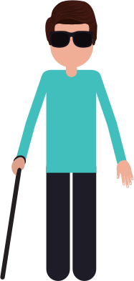
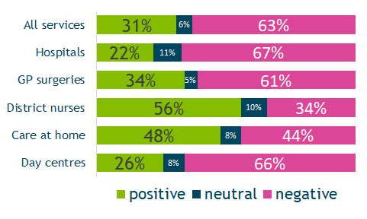
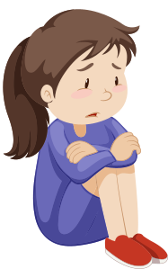
Health & Care services
  Disruptions in health and social care services have affected people's experience with health and social care services.
  People with hearing impairments and children under 18 had the most negative experience with health and social care services.
Overall, disabled people's experience of health and social care services leaned negative.
Most positive experience
  Young adults (18 to 24)
  People with sight impairments
Most negative experience
  Children (under 18)
  People with hearing impairments
Disruptions to routine hospital-based procedures, hospital outpatients and provision of day centre services impacted patient experience.
Those who received healthcare or personal care in their own homes had positive or mixed experiences with it.

Slide 28


Health & Care services
  Disruptions in health and social care services have been particularly hard on the most vulnerable respondents: those with more severe disabilities, those from BAME communities and digitally excluded.
  Hospital outpatient services, community services (such as chiropody and physiotherapy) and day centres have been the most affected by cancellations.
53%
People most affected by disruptions in healthcare/ social care:
Services experiencing the most cancellations:
of respondents experienced disruption in their healthcare or social care.
  People with more severe disabilities (unable to work or leave home, in need of personal care).
  Hospital outpatients
  Community services (such as chiropody or physiotherapy)
  People with learning disabilities.
  People living with chronic pain.
  Day centres
  People aged under 65, particularly children under 18.
  People from BAME backgrounds
  Digitally excluded people

Slide 29

Health & Care services
GP surgeries
  GP practices have adapted to dispense and prescribe medicine efficiently during the Covid-19 pandemic
  In some cases, Covid protection measures may make practices less accessible.
Overall opinion of GP surgeries
What works well
What needs improvement
  Medication is handled efficiently.
  Quality of treatment is good.
  Doctors are kind and compassionate.
  Not all GP practices are accessible.
  Online systems are not always functional.
  Practices are difficult to contact by phone.
  Communication with doctors is poor.
  People wait too long for appointments.
I have been able to talk to my GP over the phone and not had any problems getting my medication. Going forward I would like to see the telephone service stay the same as I have found it to be very convenient.
I cannot hear without lip-reading, and now my GP has to wear mask and I have to use the intercom to get through a locked door; this is difficult for me.
Don't like online consultation and telephone consultation: hard to explain things that are not visible. Prefer to see the doctor/nurse: they can see what the problem is.
(Hackney resident with lupus)
(Redbridge resident, partly deaf)
(Tower Hamlets resident, autistic)
I was Covid positive and was hospitalised for 10 days and was on Oxygen for 10 days. My GP was very supportive.
I have found the GP appointments have been ok just via video call. But information from surgery staff has been inconsistent. Have been asked to call and book my flu jab several times although have had it in last 6 months.
The nurses from the surgery have been pulled away to carry out delivery of vaccines elsewhere, therefore I can't get an appointment for my usual regular injections.
(Tower Hamlets resident with chronic respiratory issues)
The amount of people seeing a GP lessened during the pandemic and so the doctors were more accessible. The service became more personable.
(Tower Hamlets resident with mental health issues)
(Redbridge resident, carer)
(Newham resident with asthma)

Slide 30


GP surgeries- remote service
Health & Care services
  Most of those who used GP services had telephone consulatations.
  Repeat prescription requests were the most widely use online service.
Out of the 430 respondents who used GP services...
25%
23%
80%
19%
37%
used
e-consult forms.
had an
online consultation.
had a telephone consultation.
booked an appointment online.
ordered repeat prescriptions online.
I had a consultation over the phone at home, so I had my daughter explain to me what the doctor was saying and ask questions, I felt much more comfortable, I prefer it like this.
My GP does phone calls only- I had to beg to be seen face to face, there are things you just can't do in a phone call.
(Tower Hamlets resident, fibromyalgia)
(Tower Hamlets resident, fibromyalgia)
The telephone appointments seemed a good option for me, but I've been couple of times to the practice as well for routine blood tests etc. I've booked them through the app Patients Access, but I was using the system before and nothing particularly has changed.
My GP surgey don't answer their phone and I can't access the internet. I have to get someone to go on website and do online consultation.
Upsides
Downsides
(Tower Hamlets resident, multiple chronic conditions)
(Newham resident, autistic with anxiety disorder)
Trying to make an appointment online no longer exists. They need to make this happen. Long forms and telephone calls to make an appointment is crazy.
The phone and zoom consultations have worked well for me and not having to go traipsing down to the practice is a time saver whilst getting the right care.
(Barking and Dagenham resident, diabetes)
(Barking and Dagenham resident, cerebral palsy)

Slide 31
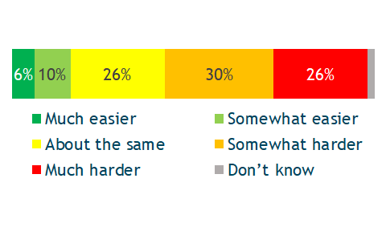

Access to GP surgeries
Health & Care services
  Most respondents found it harder than before to book GP appointments.
  In some cases, Covid protection measures may make practices less accessible.
Do you find it easier or harder to book GP appointments now?
Who had the hardest time getting GP care?
  People with sight impairments;
  People with hearing impairments;
  People with mental health issues;
  People of Asian ethnicities;
  People aged 50 to 64.
When I contacted my GP surgery regarding getting a vaccination locally where I know the area, they were very unhelpful. I had received my letter inviting me for a vaccination, but I was made to feel that I was not important and that I was jumping the queue. This could be improved by having staff with some understanding of the difficulties people like myself have.
Getting the care I need from my GP is much harder now. Harder to have them on the phone. Harder to schedule appointments. A lot of appointments moved to remote calls, but then when that isn't sufficient there are delays in being seen face to face, which means delays in care. I'm having to schedule my routine appointments myself rather than having the surgery call me to schedule them. Repeat medication needs to be requested every month rather than automatically renewing. I'd rather not see any of those continue.
(Havering resident, partly blind)
(Tower Hamlets resident with severe IBS)

Slide 32
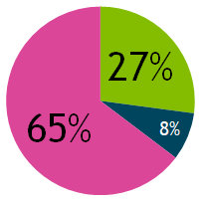

Health & Care services
Hospital services
  Hospitals are praised for the quality of the treatment they offer and the attitude of medical staff. Those who received treatment as inpatients for Covid in particular report a good experience.
  Long waiting lists and cancellations impact upon patients' access to care.
  Remote service provision makes communication with doctors harder for some patients.
Overall opinion of hospital services
What works well
What needs improvement
  Quality of treatment is good.
  Doctors and nurses are kind and compassionate.
  Those hospitalised with Covid report a good experience.
  Cancellation to routine procedures and appointments impact patient experience.
  People wait too long to be seen.
  Communication with doctors is poor.
I found hospital services easier to access, but this is just because I'm a cancer patient.
I don't understand a lot on the phone. but the doctor won't see me face to face so I can explain my health better.
(Tower Hamlets resident, deafblind cancer patient)
(City of London resident, learning disability)
I was scared to be admitted to the hospital because of Covid. But I seen they took a high standard on health and safety and hygiene issue. I am really happy about their service.
I have had no reply whatsoever from the Audiology Department to a message I left some weeks ago.
(Waltham Forest resident, sight and hearing impairment)
(Tower Hamlets resident with heart disease)
Because of pandemic most of appointments I have are cancelled until this summer. This affected me a great deal.
Very good service, and caring; even though I was affected by cancellations a great deal.
(Tower Hamlets resident, immunosuppressed)
(Barking and Dagenham resident, learning disability)

Slide 33
Health & Care services
Hospital outpatients- remote service
  Three quarters of those who used hospital services had telephone consulatations.
  Phone appointments can be more convenient for some, but they pose accessibility challenges and not everything can be done remotely.
Out of the 298 respondents who used hospital services...
18%
74%
8%
had an
online consultation.
had a telephone consultation.
booked an appointment online.
Online appointments through video calls means avoiding the commute which can cause me anxiety. It also means if the consultant is late I don't just waste time sitting in the waiting room. As they call me on a video app on my phone I don't miss appointments even if I've forgotten about them.
My consultant was aware of my deafness but still contacted me via TELEPHONE on the day of my appointment (was only notified of switch to telephone a few days prior) - no consideration for Accessible Information Standards and no response to the email I had sent that morning to advise and explain the situation.
(Tower Hamlets resident with mental health issues)
(Havering resident, Deaf BSL user)
Upsides
When I was recovering from surgery, still getting test results and making decisions about chemo, doing that over the phone was incredibly difficult. At times I wish I could easily see a nurse in the breast clinic to ask about side effects and have them check physical symptoms. On the positive side, phone consultations can be a lot more convenient than travelling and waiting for inevitably delayed meetings.
Appointments are either being cancelled at the last minute, or changed to a telephone appointment; my mum, who is my carer, has to dal with it. Some appointment would be good to keep as telephone, but vagus nerve stimulation clinic and dental must be face to face. I was also referred to the Eye Clinic at Queen's Hospital, and my appointment was then changed to telephone, which was useless.
Downsides
(Newham resident, cancer survivor)
(Havering resident with cerebral palsyr)

Slide 34
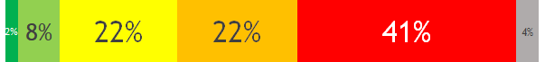
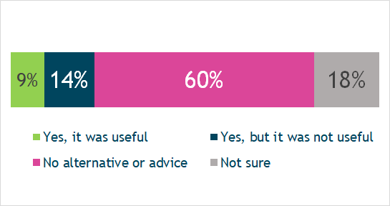
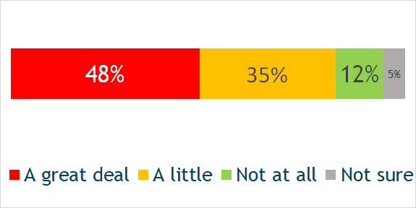
Access to hospital services
Health & Care services
  Most respondents found it much harder than before to book hospital appointments, with many being affected by service cancellations and delays.
  Those who experienced cancellations felt unsupported, as most of them received no help in managing their health in the meantime.
Do you find it easier or harder to access hospital care now?
Those who experienced cancellations felt poorly supported to manage their own health, with only a minority receiving any alternative or advice:
Did you receive any other alternatives or advice on how to manage your health after your hospital appointments were cancelled?
77%
of those who used hospital services experienced cancellations.
48%
of them said cancellations affected them a great deal.
To what extent did hospital cancellations affect you?
Accessing the hospital has been much harder since all appointments have been cancelled and have not yet been offered any new ones. I need to see a neurologist, a Parkinsons specialist nurse and the eye clinic for glaucoma.
I have had a number of appointments cancelled, and I waited over 7 months for a new hearing aid mould after one broke.
(Havering resident, hearing impairment)
(Havering resident with Parkinsons)

Slide 35


Health & Care services
Mental health services
  Access to mental health services is difficult for many, as services are overstretched and waiting lists are long.
  When people can access mental health services, they have positive experiences and adapt well to online or telephone sessions.
  Communication about changes to services in the pandemic needs improvement.
Overall opinion of mental health services
What works well
What needs improvement
  People find therapy and/or treatment helpful.
  Online systems for accessing mental health support work well.
  Communication with mental health services is poor.
  People wait for a long time to get any kind of mental health support.
  There is limited choice for where and how to receive mental health support.
Mental health services have been very responsive via emails and can do online video call - really straightforward.
I had to rearrange some counselling appointments, so I missed some. They should have been clearer that they changed all the appointments to over the phone in the beginning. This would have made things clear and I may not have missed my appointments.
I tried to self refer at a crisis point during 1st lockdown; I also tried to get a referral to the counsellor attached to the Renal team at The London. Unfortunately, all were too busy and other known orgs such as Mind etc just signposted my to mindfulness on line - this was so not what I needed at the time.
(City of London resident)
I wasn’t feeling great, so I reconnected with the IMPART service and they got me help. I have experienced some cancellations, but useful alternatives were provided.
(Tower Hamlets resident, depression)
(Havering resident with psychosis)
(Hackney resident, kidney disease)

Slide 36
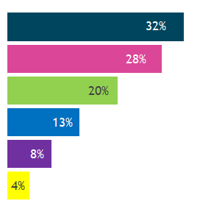

Health & Care services
Mental health- remote service
  Most respondents who received mental health treatment or support did so through their GP, a hospital-based service or Community Mental Health team.
  Most types of consultation and mental health treatment have been carried out over the phone or online.
Who respondents received mental health treatment or support from:
Out of the 143 respondents who used mental health services...
GP surgery
20%
26%
13%
20%
had a therapy session online
had a therapy session over the phone
spoke to a psychiatrist or mental health nurse online
spoke to a psychiatrist or mental health nurse over the phone
NHS hospital
CMHT
6%
10%
NHS therapist
booked mental health appointments online
used a mental health app or website
Charity
Private
My mental health problems started during the pandemic. So it was difficult initially to speak to my GP without having to explain everything to the receptionist. They were helpful because as soon as I told them I am blind and my daughter is partially sighted so cannot access online services I got a call from my doctor.
(Tower Hamlets resident, blind)

Slide 37
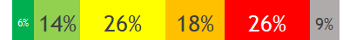
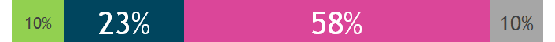
Access to mental health services
Health & Care services
  Mental health services experienced cancellations and disruption in the Covid-19 pandemic, though not to the same extent as hospita outpatient services.
  Those who experienced cancellations felt unsupported, as most of them received no help in managing their health in the meantime.
Do you find it easier or harder to access mental health support now?
Those who experienced cancellations felt poorly supported to manage their own health, with only a minority receiving any alternative or advice:
Did you receive any other alternatives or advice on how to manage your health after your hospital appointments were cancelled?
31%
of those who used mental health services experienced cancellations.
I have waited for over a year and nothing has happened.
I find access to the Community Mental Health Nurse somewhat harder. Too many restrictions, barriers, it's dehumanising. Too much delay, long waiting time/list, having to tell your story again and again is exhausting.
66%
of them said cancellations affected them a great deal.
(Hackney resident, hearing impaired)
Because of the pandemic all face to face appointments have been canceled. so I'm having a very hard time.
(Tower Hamlets resident, autistic)
of those not currently accessing any mental health services felt they needed mental health support but couldn't get it.
Unable to use mental health services. It is much harder to access mental health services. A waiting time of 4 months occurred, where 4 months later they said they don't see children under 11.
38%
(Tower Hamlets resident)
Covid stopped face to face assessments so my Asperger's diagnosis took much longer.
(Havering resident, autistic)
(Barking and Dagenham resident, mother of child with learning disabilities)

Slide 38
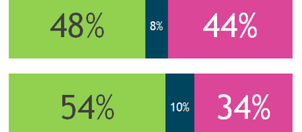
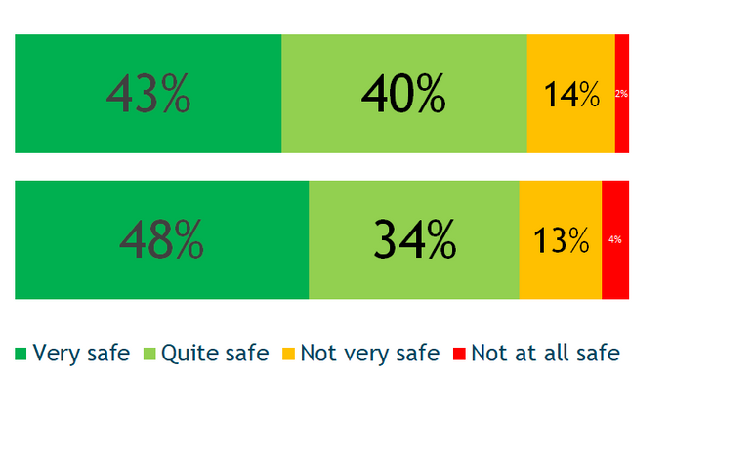
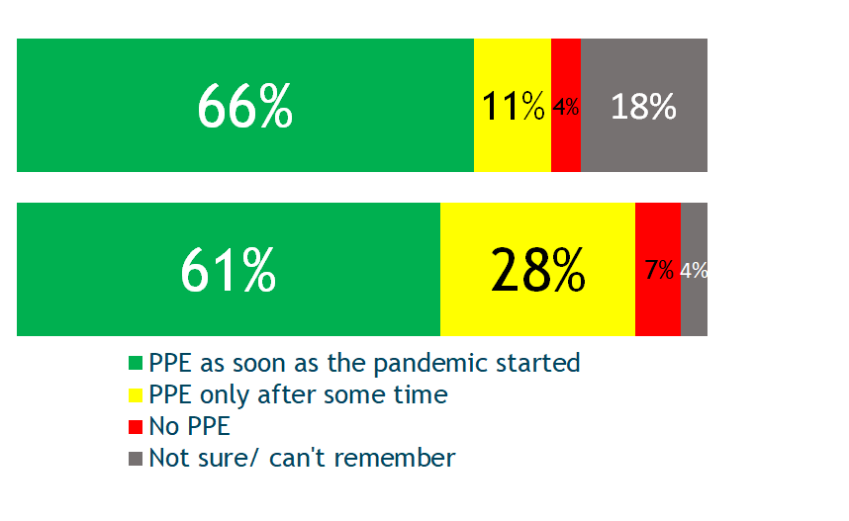
Health & Care services
Healthcare and personal care at home
  Communication between patients and healthcare providers, particularly around changes in service provision caused by the Covid-19 pandemic can be lacking.
  Most nurses and carers started wearing appropriate PPE as soon as the pandemic started; but in a minority of cases there were delays in implementing Covid safety measures.
Overall opinion of care at home
How safe do you feel having care professionals in your home?
District nurses/ healthcare at home
District nurses/ healthcare at home
It has been somewhat harder to access community health services since the lack of communication was really bad. The district nurse turned up un-announced and let herself in which was very worrying and disrespectful behaviour. Said she could do it because she's a nurse!
Carers and personal assistants
Carers and personal assistants
What works well
(Barking and Dagenham resident, family member of stroke survivor)
  District nurses and carers offer a good quality of care and support, with a pleasant attitude.
Did health professionals wear personal protection equipment?
Government allocated extra hours for Carers to come to our home but the Care Agency didn't have any knowledge about this. It took multiple phone calls to the local council and the care agency to resolve this and finally get the extra help. A big let down mentally.
District nurses/ healthcare at home
What needs improvement
Carers and personal assistants
  Because of Covid-related disruptions, people see their carers less often.
  Communication around changes in service is often poor.
(Redbridge resident, carer for wheelchair user mother)

Slide 39


Health & Care services
Day centres
The closure of day centres negatively impacted disabled people, leading to poorer mental health outcomes and social isolation.
15%
89%
54%
of respondents were using day centres pre-pandemic
of them stopped attending while day centres were closed in the Covid-19 pandemic.
of them took part in online activities organised by their day centre/
Most affected:
ONLY
I had less to do and I was not able to meet up with my friends. The center was running some online stuff but I am not comfortable with all that.
71%
34%
  People aged under 65.
  People of Black ethnicities.
  Men
  People with learning disabilities.
  People with hearing impairments.
of those whose day centre closed said closures afected them "a great deal".
of those whose day centres were closed received any alternative care arrangements or support.
(Tower Hamlets resident, living with chronic pain)
He's more isolated. We've seen so few people for the last year. I'm responsible for him 7 days per week 24hrs per day. The morning at the day centre used to give me headspace and a chance to clear up!
Those who took part in online activities were as likely to feel impacted as the ones who did not.
(Tower Hamlets resident, spouse of stroke survivor)

Slide 40
What diffeerence has it made
Questions for the health and care system
Feedback on the best methods to reach different impairment groups was implemented by the ICS Comms and engagement team as soon as they recieved the information. This helped inform the location and re location of vaccine centres and the production of videos, Easy Read and webinars for specific impairment groups. We are now informing the third phase of the vaccine programme
Vaccine roll out
Health care services
Our profiling of those at risk of digital exclusion was used to train hospital and GP staff to help them to continue to reach everybody in the community.
communication preferences are being used to inform both improvement in hospital accessible information standards but also to help manage the long delays in elective care that will be a consequence of Covid.
We are participating in a wide range of quality improvement, transformation and co-design programmes including improving hospital communication systems and helping to even out GP services across the ICS

Slide 41












Acknowledgements
This report is the combined work of the eight North East London local Healthwatch, the North East London Clinical Commissioning Group and Healthwatch England. The Local Healthwatch also worked with their own voluntary and community sector partners to reach residents from a wide range of back grounds and impairment groups.
We would particularly like to thank all of the local residents who took the time to complete the survey during what were very difficult times. We are committed to ensuring that your insights continue to make a difference to health and social care and hope you will continue to work with us we help the health and care system to build back better.
Vaccine roll out

