Slide 1
COVID-19:
Our Response and Approach to Recovery

Slide 2
COVID-19 response overview
The impact of Covid-19 has tested the NHS to the limit; and we are still in an emergency situation. We are very keen to inform and engage with our stakeholders to let you know about the actions we have taken in City & Hackney, as well as at a NEL level, and those we have yet to put in place. We have already achieved a lot in a short time, including realigning our workforce to focus on responding to the pandemic, building capacity and offering services in totally different ways.
Covid-19 is a very dangerous disease and there is still a huge amount to do. Infection control and segregation will be critical to keep patients and staff safe. We need to:
provide Covid-19 care for the foreseeable future
provide capacity and capability to manage future Covid-19 other pandemic peaks
continue to safely deliver non-Covid-19 urgent and elective care and clear backlog
We also need to do this effectively and efficiently as we continue to face significant pressure on our resources as a result of this pandemic.
Our NHS has stood firm in the face of incredible adversity. The joint working between different health and social care organisations, especially our voluntary sector in this crisis, has been inspirational and we are highly motivated to build on these new and more positive partnerships.

Slide 3
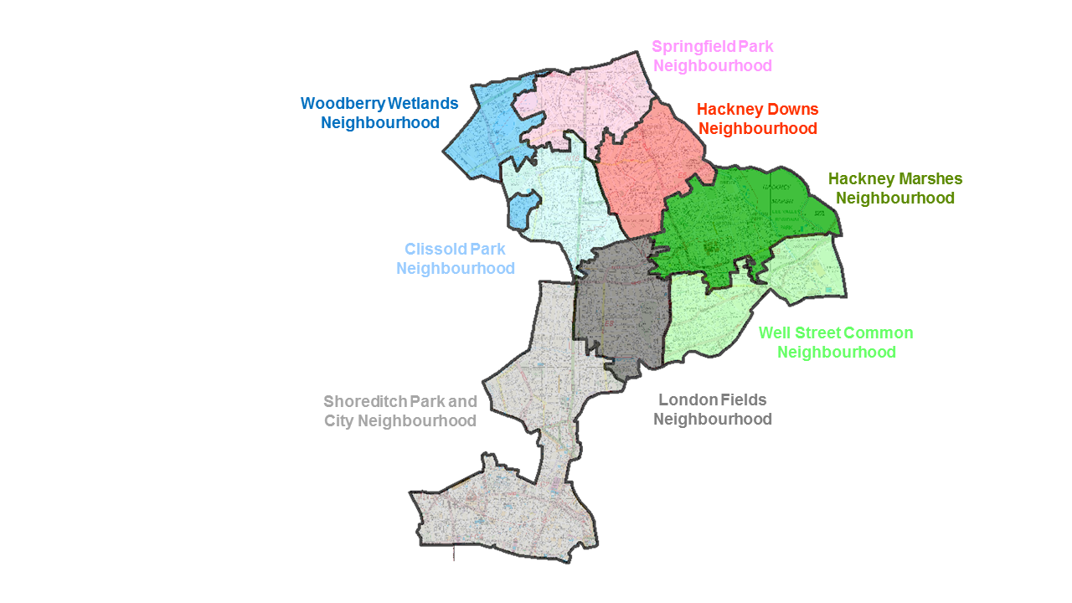
Our Neighbourhood approach
Across City and Hackney we have 8 Neighbourhoods with populations of between 30,000-50,000 people.
Neighbourhoods have been formed as far as possible around natural communities. They are based on GP registered lists and groups of GP Practices. In City, it is the Shoreditch Park and City Neighbourhood.
A huge amount has been done locally to support vulnerable people during COVID-19. We recognise that many frontline teams have and will continue to be supporting people who have complex needs. This is heightened by the current situation but the approach we are developing will extend beyond our immediate response to the pandemic.
The Neighbourhood approach is about supporting multi-agency working within communities. We have already commenced working with teams across primary care & community teams, adults and children’s social care, education and other services to support coordination of care and support for those most vulnerable residents across City and Hackney. This might include any of the following:
People who are falling between the gaps between services
Where there is a presence of serious unmanaged conditions
Where the case has touched a number of different professionals
Where there are recurrent crises or frequent incident reports.

Slide 4
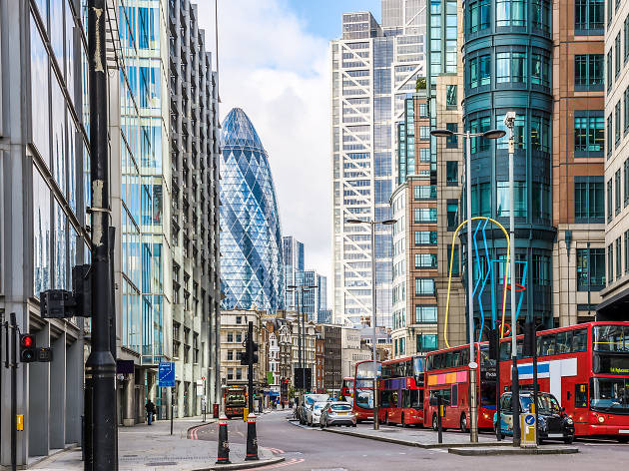
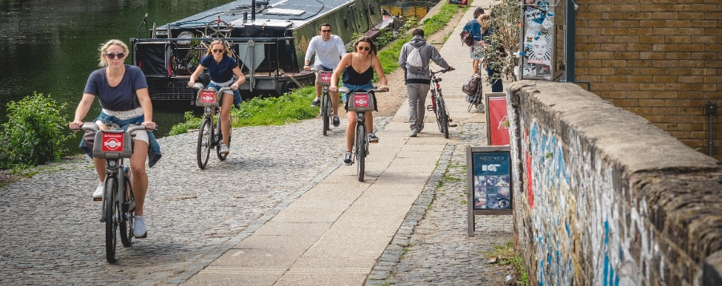
Our Neighbourhood approach involves…
A link member of staff for each Neighbourhood from each service. This is a touch-point into the Neighbourhood. It is aimed to enhance multi-agency working.
A link into specialist teams (likely spanning multiple Neighbourhoods) to ensure specialist support is available when needed. Specialist teams may be required to attend the Neighbourhood MDM where appropriate or support follow-up needed.
A regular virtual Neighbourhood MDM discussing adults and children/families with complex needs. These are people who cannot be held within individual organisations and who need improved multi-agency support.
Neighbourhood conversations (already commenced) facilitated by the voluntary and community sector. Bringing together voluntary organisations as well as statutory partners and local Elected Members to support the local responses to COVID-19.

Slide 5
The North East London approach to recovery
The existing East London Healthcare Plans https://www.eastlondonhcp.nhs.uk/ourplans/ underpin our approach to recovery with strategic planning at the Integrated Care System (North East London) level and delivery through more local partnerships, boroughs and neighbourhoods.
We should retain the best working practices from our experience of managing the Covid pandemic, but we will test what we have put in place to ensure the changes meet the needs of the whole population, making adaptions where necessary.
Staff are key to recovery and will be supported and fully engaged in defining and embedding new ways of working.
Clinical leadership, supported by managers, is paramount. Decisions will be based on data and evidence. We will meet the requirements of the various clinical guides and NHS operating framework https://www.england.nhs.uk/coronavirus/.
Equalities will be woven through all aspects of the recovery & restoration programme.
Health and social care will be given equal focus, and solutions will meet the needs of the population rather than institutions.
Clear, two-way, diverse communications and engagement with local populations will shape and endorse changes.

Slide 6
Recovery plan summary (dates indicative)
May to July 2020
1. We will engage with patients, public and stakeholders to gather evidence of the impact of recent and changes made to meet the challenges of the current emergency to ensure the changes deliver the intended benefits. The Neighbourhood Conversations work will be fundamental to this.
2. We will introduce new measures. This will enable us to resume planned care in the safest way possible, reduce the backlog of treatments, and be in the best position for any 2nd peak in Covid (or any other pandemic). In particular, the principles of infection prevention and control mean patients need to receive care in a fundamentally different way. We will work with local people and partners to ensure the implications of these changes are carefully considered.
reduce urgent and emergency activity by at least 25% to create capacity to manage planned care
separate urgent and planned patients, Covid and non-Covid patients. This can partly be achieved by redeveloping our estate, and partly by using new working practices such as virtual appointments, phone triaging etc.
review and strengthen our actions to address health inequalities that are a) already in the system b) have become apparent in the way that Covid has affected parts of the population
build on the strengthened partnerships to promote and embed integrated care across all services, ensuring community settings are the default choice for service development
work with our staff to help them stay resilient and adapt to new ways of working using new technology
3. We will engage with patients, public and stakeholders to discuss their experience of services.
4. We will take decisions on the future of a new health and care system for London.
June to Nov 2020
Continuous Engagement
Feb to Sept 2021
Nov 2021

Slide 7
Opportunities
NHSE/I have established 12 expectations from local health systems to meet the challenge of future healthcare needs. Many expectations focus on improvements we have been trying to put in place for many years. Below sets out early thinking on how the NEL health system, including City & Hackney could meet the 12 expectations.
1. Build capacity
A permanent increase in critical care capacity and surge capability, centred on tertiary sites
Minimise hospital stays e.g. same-day emergency care; community-based rapid response
Further consolidation and strengthening of specialist services
Segregate the health and care system between Covid and non-Covid; urgent and elective work especially by site
Virtual by default unless good reasons not to be for e.g. primary care, outpatients, diagnostics, self-care
Single ‘talk before you walk’ points of access for all pathways
New community-based approaches to managing long term conditions (LTCs)/shielded patients
Consolidate corporate services and share clinical support services
New integrated workforce and volunteer models and new incentives to deliver these new models of care
Further alignment and joining together of institutions within the ICS (i.e. Neighbourhoods)
Disproportionate focus and resources for those with most unequal access and outcomes
A new approach to consent through systematic deliberative public engagement e.g. citizens juries
2. Prevent infection
3. Develop a flexible workforce
4. Put public and staff first

Slide 8
Key risks to consider
These plans all require significant changes to the workforce, the way we work and our ability to train and recruit people to new roles. We also need to recognise that not everyone will want to change and many staff will have been affected by the emergency.
New ways of working, which will be paramount to delivering improvements, must consider the views of staff and endeavour to make their roles less burdensome, more productive and more fulfilling.
2. Some of these changes represent a fundamental shift in the way many people will access health services.
Current arrangements will remain in place whilst we engage with clinician, staff and our diverse local population to further shape and define the new offer.
We may need some support from NHSE/I on helping to manage some changes to services.
The digital/virtual changes do not suit all service users and there are plans to return to face-to-face contact for example people with learning disabilities and autism as soon as is practical.
Equality impact assessments will be required to ensure that no groups are disadvantaged by these changes and we reduce existing inequalities where possible. We will ensure that the full implications of these changes are assessed over time to make sure that the positive benefits are sustained, and any negative impacts are understood and mitigated against.
The clinical complexity of patients is likely to increase and we must ensure our capacity reflects the impact of this on length of stay and the needs to rehabilitation in the community.
The financial implications of these changes are significant , requiring capital investment and require resources to move around the system. We will develop a comprehensive financial plan and risk sharing approach to ensure that the resources are there to do the right things.

Slide 9
In summary
We need to meet the existing challenge to provide Covid care and reduce infections; provide more capacity; and restart, safe delivery of non-Covid care whilst still in an emergency.
For many services we will be asking patients to continue using the new ways of virtually meeting with the NHS. It is safer, reducing the chance of patients contracting Covid-19 or other healthcare acquired infections (existing or future); more convenient for many patients; and it is more efficient, enabling us to spend our budget wisely.
For services that need patients to come into a hospital or NHS building we are following national advice and guidelines to minimise the risk of infection. Over the next few months we will be making every effort to segregate Covid and non-Covid patients, and planned and unplanned patients. This may mean that patients are asked to attend a hospital that is not closest to them.
Over the summer we will be engaging with patients, the public and key stakeholders to understand their experiences of new services and to ensure new measures we are taking are fit for purpose.
Some of these changes are aligned with previously agreed plans (i.e. the health system has planned to separate some of our services for many years). Over the next year we will be working with all those interested, particularly those who may be marginalised or who have particular needs, to work out how we can make this work for everyone. We will ensure we meet all legislative engagement/ consultation needs; and at the end of that time we will make decisions on a future NHS and care service that meets the needs of the whole population.

